Slide 1
Social Trends of China
Group 13
Display various aspects (agriculture, industry, tourism and transportation etc.) of China over the past decade by data visualization to show the overall trends.
2) Design proper visualization diagrams and interaction ways to show the data and its inter- connections.
Members: Jiang Xinhou Yang Yonggui
Yu Qingtian Wang Kaili

Slide 2
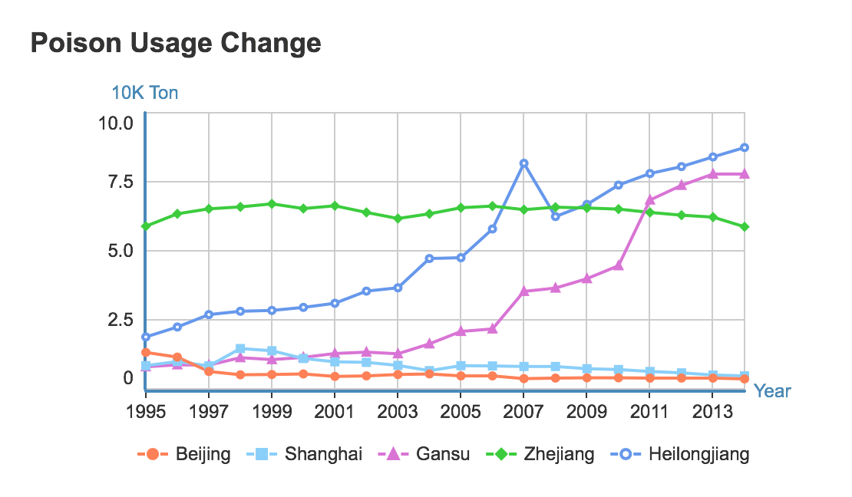
1.The role agriculture plays in economy

Slide 3
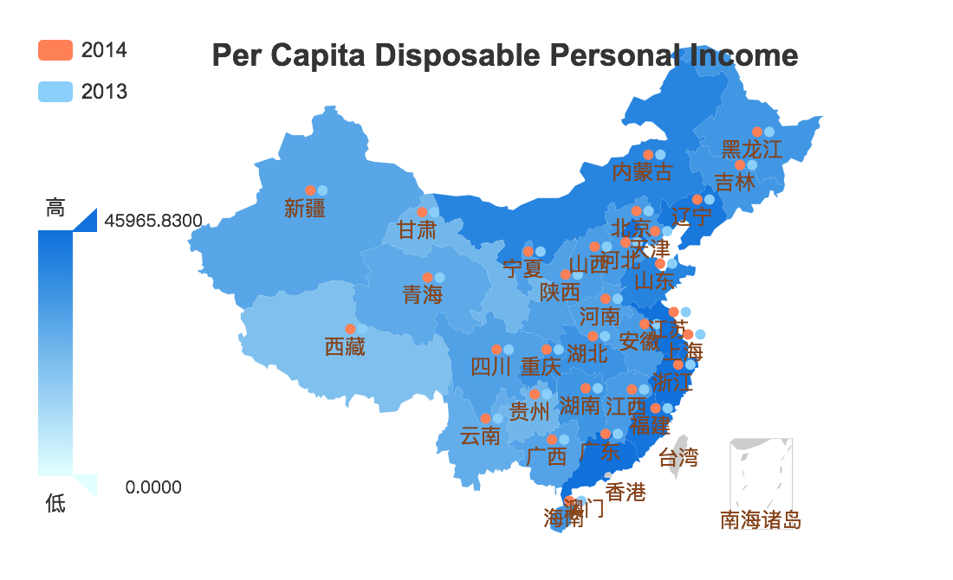
The role agriculture plays in economy

Slide 4
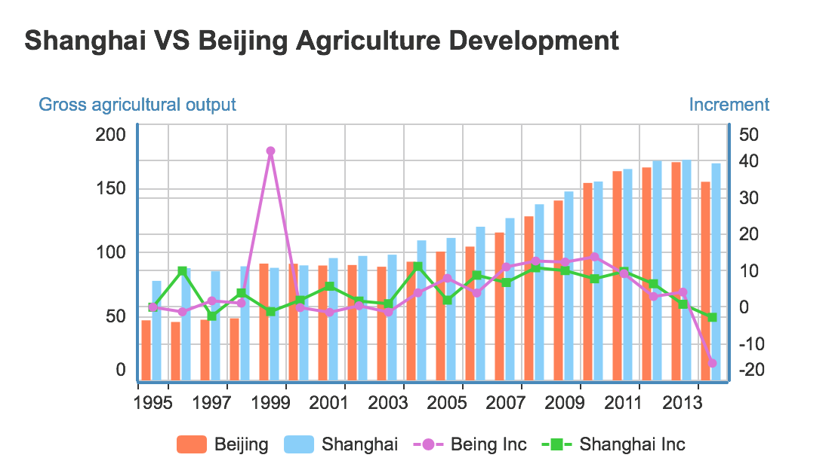
The role agriculture plays in economy

Slide 5
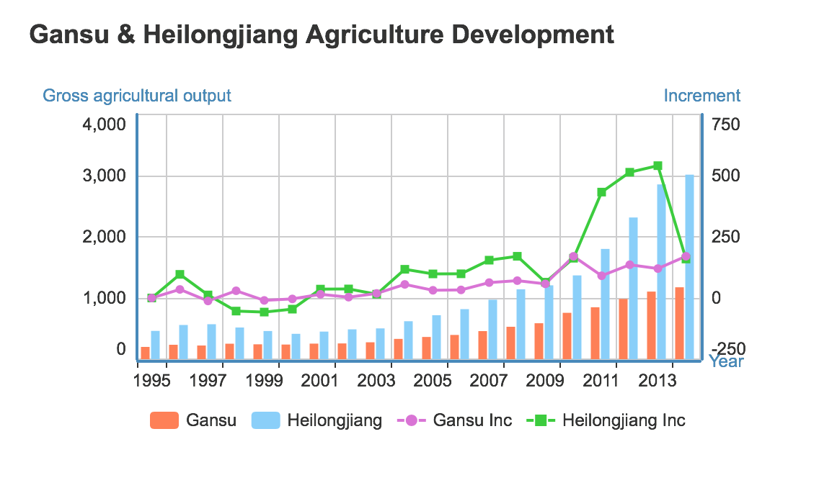
The role agriculture plays in economy

Slide 6
the quantity of berth in inland and costal port.
2.Transportation (specifically harbors) Analysis

Slide 7
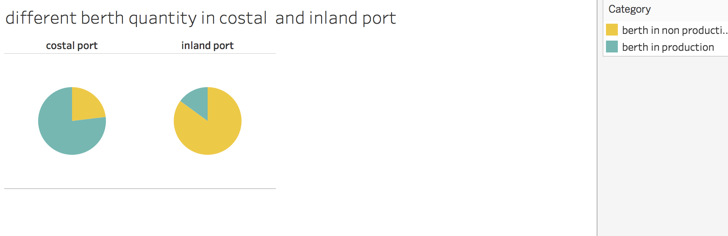
Transportation (specifically harbors) Analysis

Slide 8
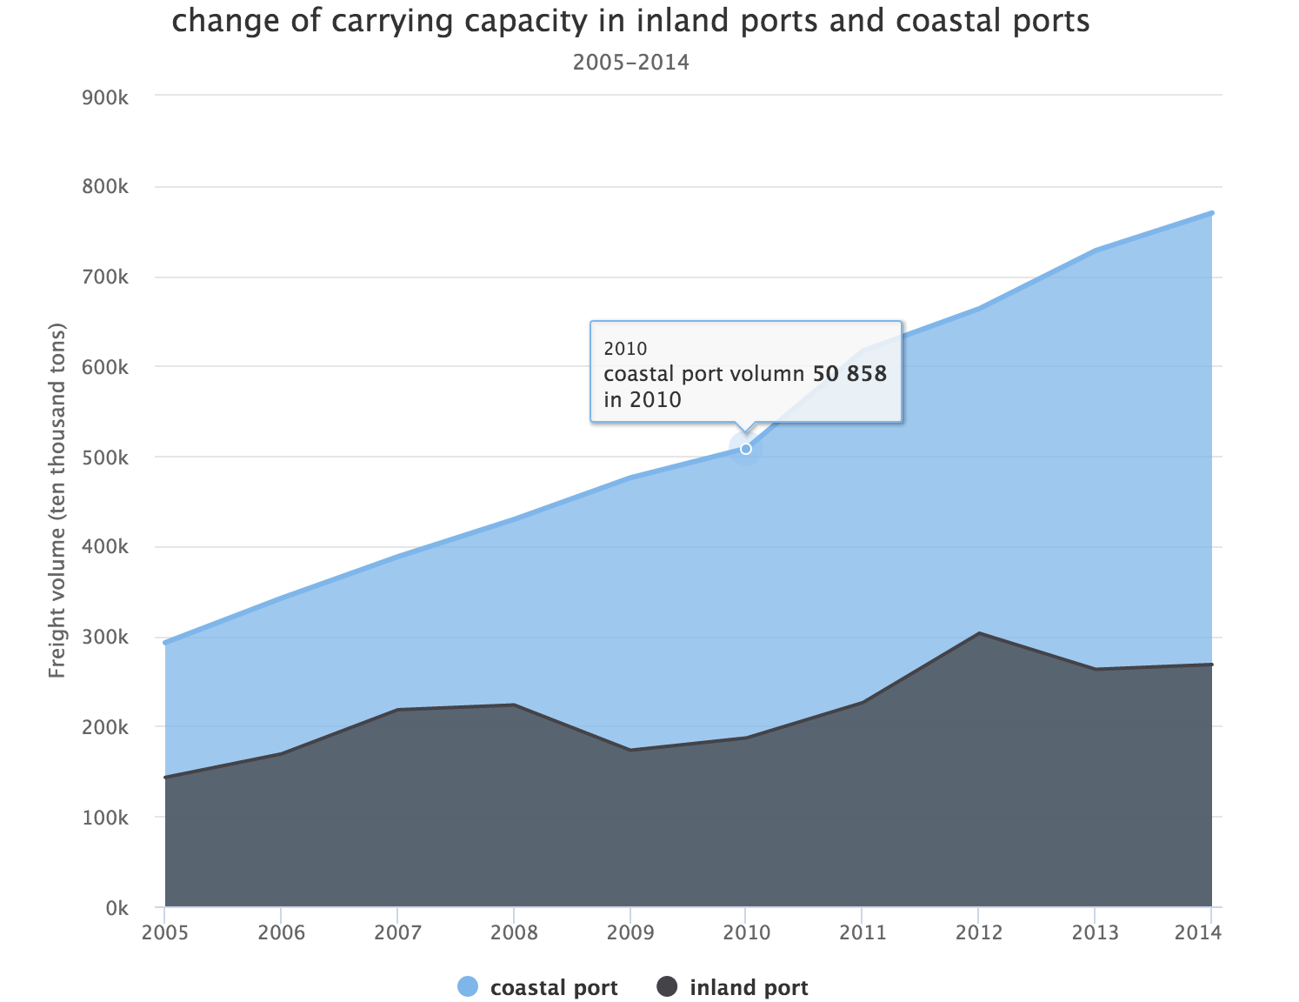
Both in inland and costal port , the volume of carrying capacity is rising . The volume of carrying capacity in costal port is almost twice of that in inland port. Almost the quantity of the berth in every port increases as time goes by .And the increasing speed of the quantity of costal berth is faster..
Transportation (specifically harbors) Analysis

Slide 9
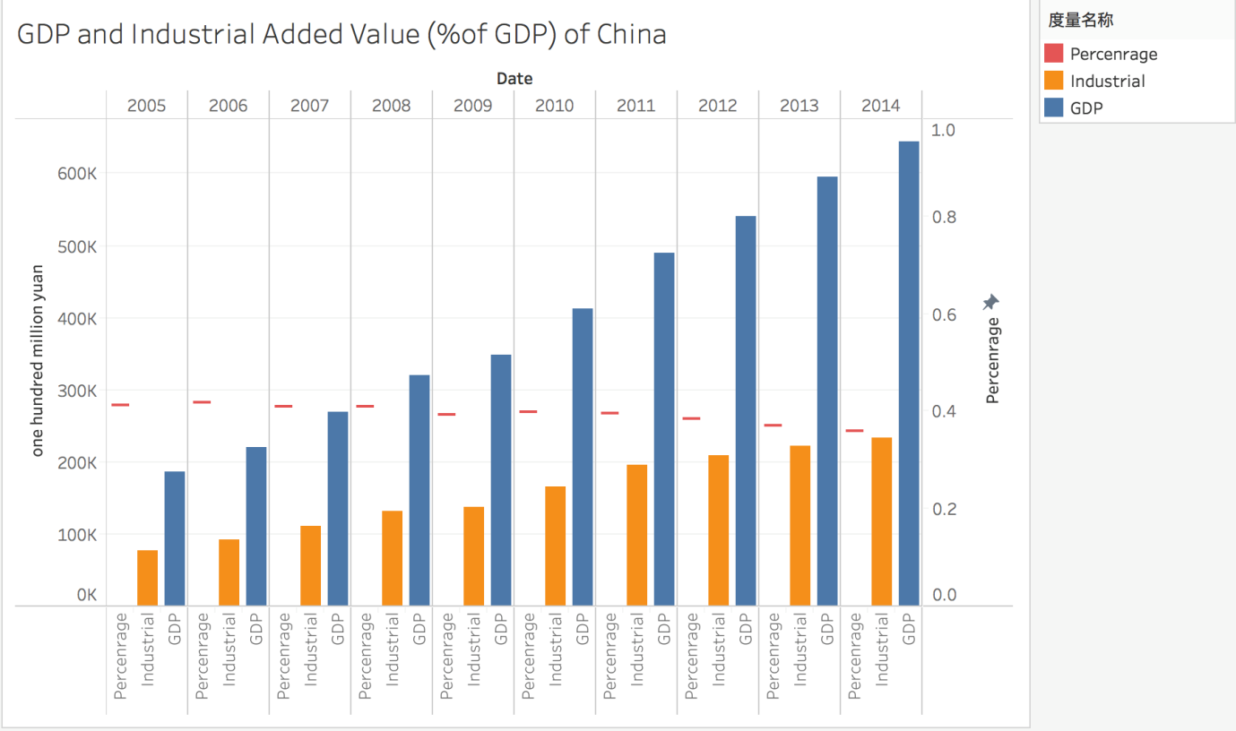
3.Development of Industry
1.GDP and industrial added valve in China

Slide 10
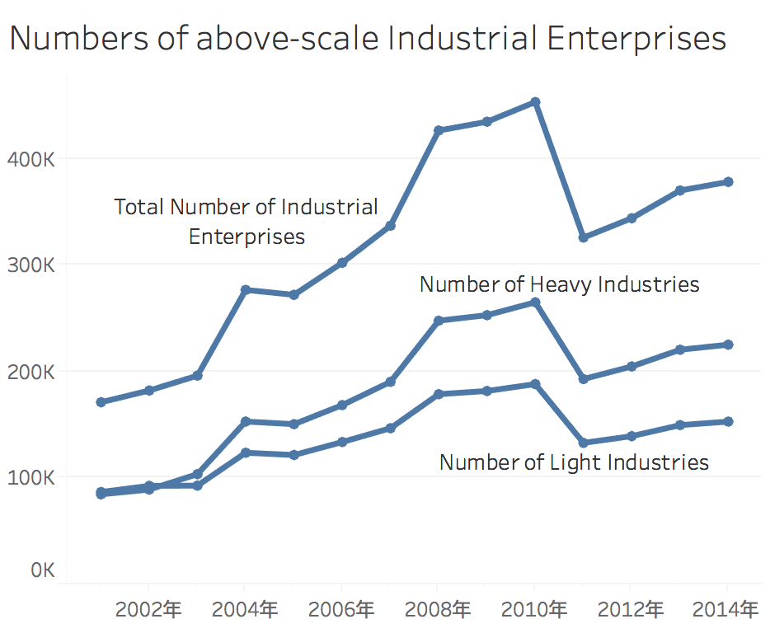
Development of Industry
2.Numbers of Above-scale Industrial Enterprises
Revenue from main operations
2001-2011:
Above 5 million Yuan
2011-2014:
Above 20 million Yuan

Slide 11
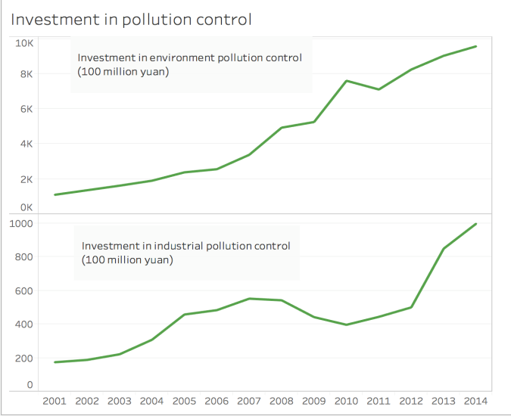
Development of Industry
3. Investment in Environment Pollution Control

Slide 12
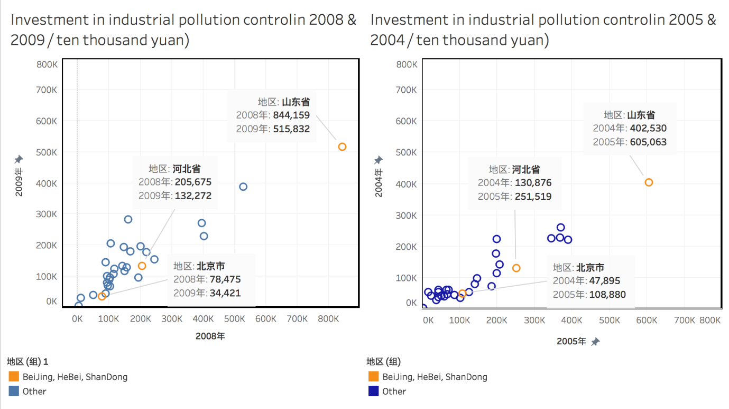
Development of Industry
4.comparison between investment in industrial pollution control in
2005 & 2004 2008 & 2009

Slide 13
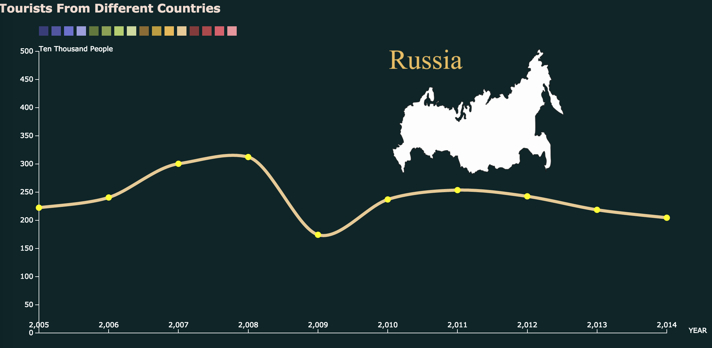
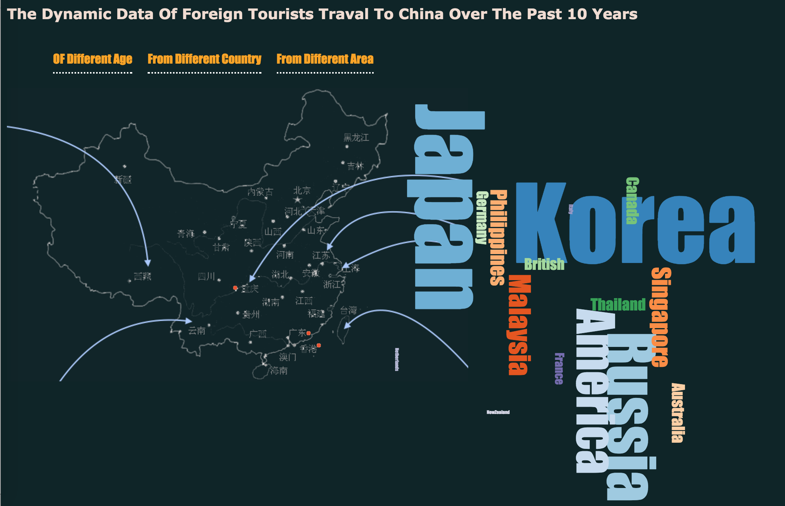
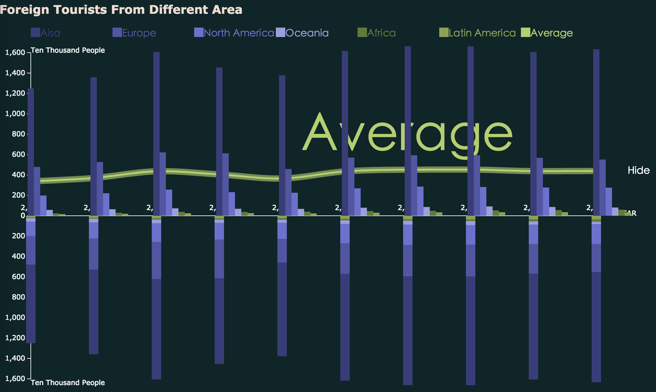
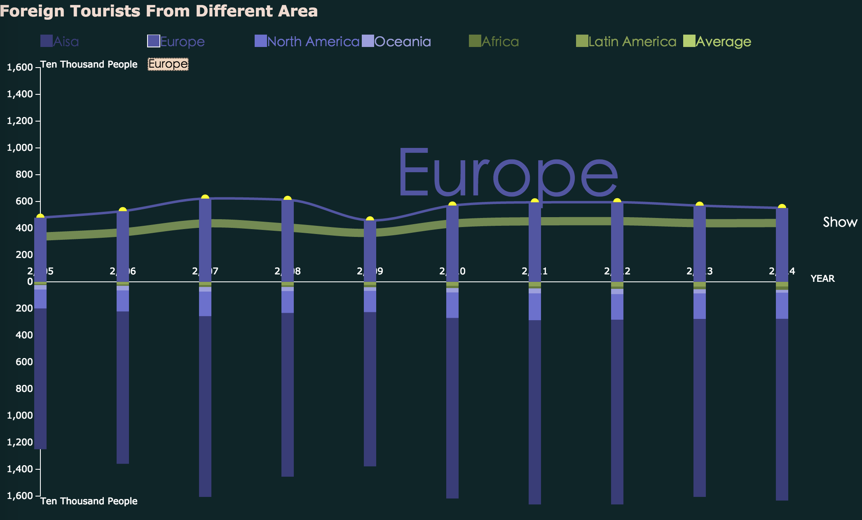
4.Tourism data over the past decade
From different countries
From different continents
Of different age group
D3.js JQuery
Notes:
Hello, every one, from my part, I did the visualization for the tourism data of china over the past ten years, and I specially designed and developed these diagrams with d3.js and jquery for that.
Besides, my works mainly focus on how many foreign tourists have travelled to china since 2004, and the selected data cover three topics: their age groups, countries and areas.

Slide 14
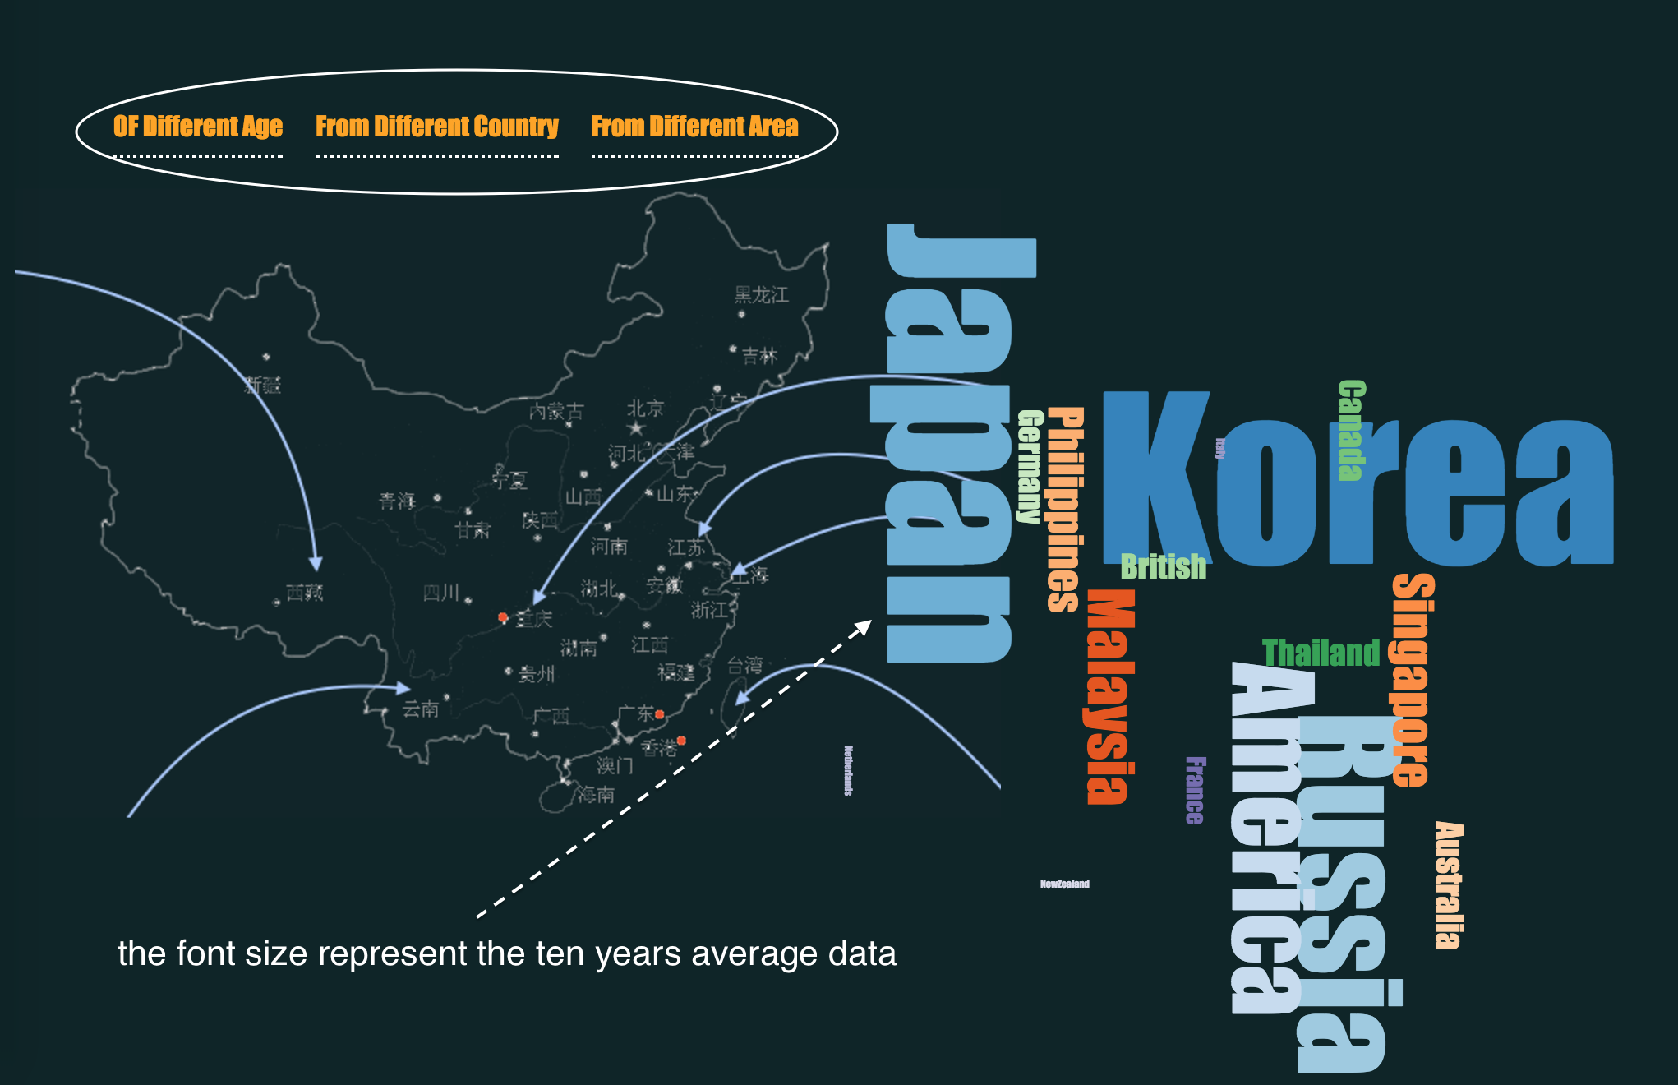
Preview the ten years average data by generating ‘Tag Clouds’
Notes:
1.Now in this index page, for preview, I roughly show the ten years average data of each topic by generating some tag clouds. the font sizes are corresponding to the average data size.from the tag clouds, we can easily know those tourists are mainly adults and middle-ages, range from 25 years old to 64 years old and they are mainly from japan、korea and russia these asia countries.

Slide 15
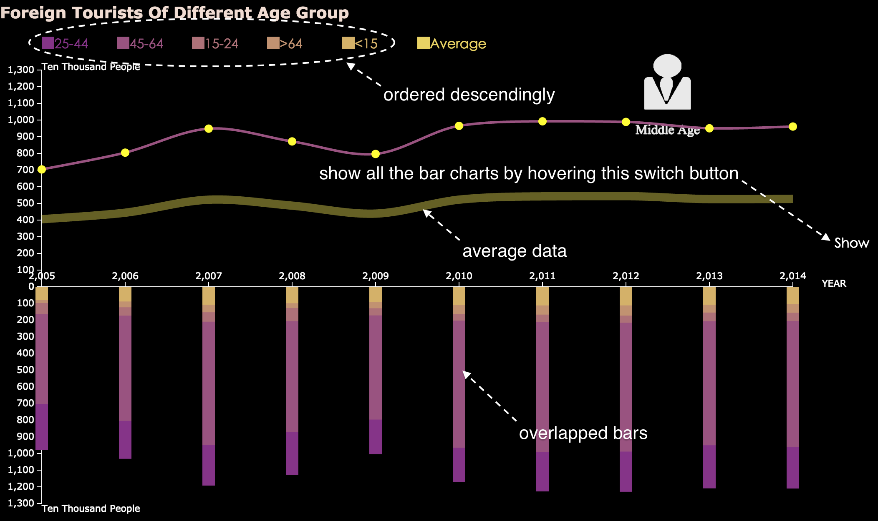

Slide 16
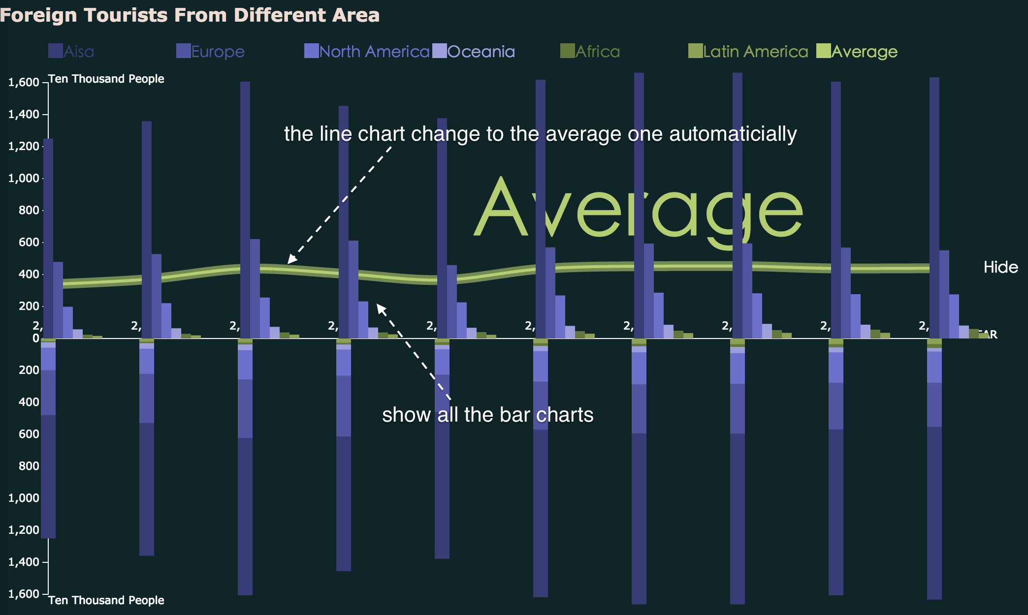

Slide 17


